Slide 1
Logical Database Design &
Relational Model
Lecture - 06

Slide 2
Learning Outcome
LO3: Model data requirements using data models

Slide 3
In this lecture you will learn
What is logical database design?
How to derive a logical model from the information represented in the ER model (Conceptual Model)
We focus on one type of logical model which is relational model

Slide 4
Relational Model
Data model on which most DBMS implementations are based. (CODD 1970)
Simple & Elegant model:
  Everything is a relation (= Table)
  Every relation is a table with rows & columns
There are standard ways to convert from
ER model (Conceptual Model )
Relational model (Logical Model )

Slide 5
Relational Model (contd.)
The relational model represents the database as a collection of relations.
Relation consists of
  Relation Schema
  Relation Instance (Table)

Slide 6
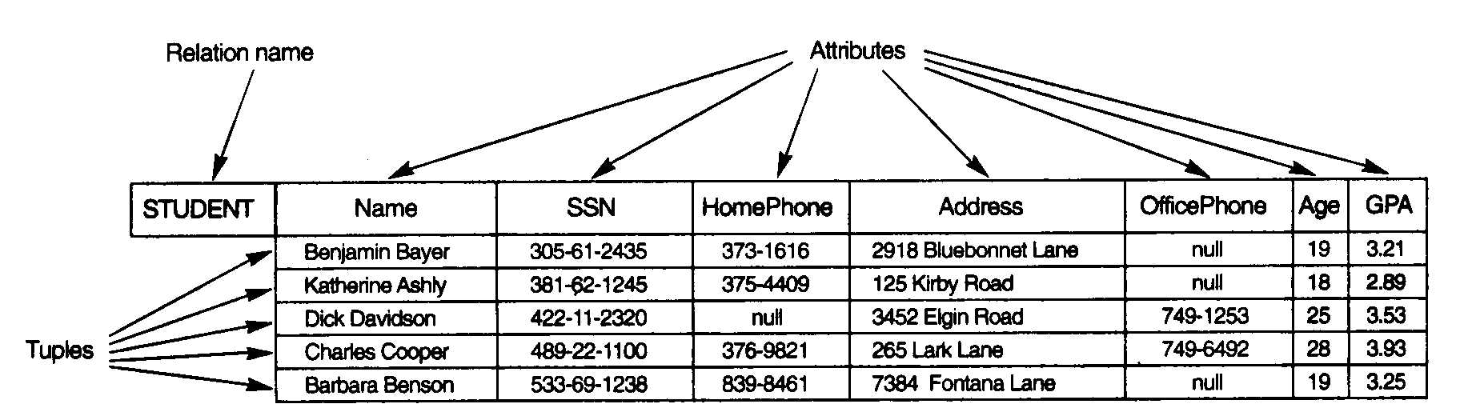
Relation
RELATION:
  Schema
  Instance

Slide 7
Relation Schema
Describes the column heads (Attributes) of the relation
  name of the relation,
  name of each filed,
  domain of each field
    Domain : is described by domain name and set of associated values.

Slide 8
Relation Schema
Students
(sid:string,
name:string,
login:string,
age :integer,
gpa :real )
Schema Name(relation name)
Field name
domain
Domain GPA : real (0-4)

Slide 9
Relation Instance
Set of tuples or records or rows.
Each tuple has the same number of fields as the relation schema
Example : Relation Instance

Slide 10
Degree of a relation
The degree of R is the number of attributes in R
(ID,Name,Address,Phone) = 4
ID | Name | Address | Phone
100 | Sampath | Moratuwa | 01992883
110 | Amali | Colombo -3 | 01983733
120 | Sanath | Negombo | null

Slide 11
Example
Make a list of students in the class, keeping their ID, name and phone number.
This is the basic structure of the relation model, a table or relation.
ID | Name | Phone No
S01 | Mike | 011 2233445
S02 | Elisa | 022 3344556

Slide 12
Formalizing : Relations
A relation is a named table of data.
Table is made up of rows (records or tuples), and columns (attributes or fields)
Not all tables qualify as relations. Requirements:
Every relation has a unique name
Every attribute value is atomic (not multivalued, not composite)
Every row is unique (can’t have two rows with exactly the same values for all their fields)
Attributes (columns) in tables have unique names
The order of the columns is irrelevant
The order of the rows is irrelevant

Slide 13
Formalizing Key Fields
Primary key (PK)
Minimal set of attributes that uniquely identifies a row
This is how we can guarantee that all rows are unique
Foreign key (FK)
Set of attributes in a table that serves as a reference to the primary key of another table

Slide 14
Foreign Key
A constraint involving two relations
  referencing relation
  referenced relation.
Tuples in the referencing relation have attributes FK (called foreign key attributes) that reference the primary key attributes PK of the referenced relation
Display the foreign keys by drawing an arrow from the foreign key to the primary key
referencing
Enrolled (cid ,grade, studid)
FK
Students (sid, name ,login, age, gpa)
referenced
PK

Slide 15
Integrity Constraints - IC
DBMS must prevent entry of incorrect information.
To prevent : Constraints / conditions are specified on a relational schema = ICs
Database which satisfies all constraints specified on a database schema is a legal instance.
DBMS enforces constraints - permits only legal instances to be stored.
When the application is run the DBMS checks for the violation and disallows the changes to the data that violates the specified IC.

Slide 16
Integrity Constraints
Specified and enforced at different times.
  Specified : When the DBA /end user defines the data base schema
  Enforced : When database application is run
    DBMS checks for violations
    Disallow violating entries

Slide 17
Integrity Constraints
Many kinds of ICs:
  Domain constraints
  Key constraints
  Entity integrity constraints
  Referential integrity constraints

Slide 18
Domain Constraints
Domain constraints: value in the Column must be drawn from the domain associated with that column
Restricts the :
  Type
  Values that can appear in the field
Eg.
    Name Char (25)
    GPA (real >=0, =<4)

Slide 19
Key constraints
Is a statement that;
  A certain minimal subset of the fields of a relation is a unique identifier for a tuple.
Which Means
  Two tuples in a legal instance cannot have identical values in all the fields of a key.

Slide 20
Constraints…
Entity Integrity Constraints: states that primary key values cannot be null.
  This is because primary key values are used to identify the individual tuples.
Referential Integrity Constraints
  Sometimes information stored in one relation is linked to information stored in another relation.
  If one is modified the other must be modified to keep the data consistent.
  An IC involving both relations must be specified.
  IC involving 2 relations is a foreign key constraint.
  Foreign keys enforce referential integrity constraints.

Slide 21
Referential Integrity
The value in the foreign key column ( can be either:
  a value of an existing primary key in the referenced relation or a null.
FK
PK
Students
cid | grade | stuid
Carnatic101 | C | 53666
Reggae203 | B | 53666
Topology112 | A | 53650
History105 | B | 53666
Enrolled

Slide 22
DB operations & Constraints
IC are specified when a relation is created and enforced (checked) when a relation is modified.
3 types of modifications to the relation :
  Insert : inserts a new tuple(s) into a relation.
  Delete : delete tuple(s) in a relation.
  Update : changes the values of some attributes in existing tuples .

Slide 23
Insert Operation
The insert operation can violate the following constraints:
  Domain constraints (invalid value)
  Key constraints (duplicate key values)
  Entity integrity constraints (null primary key value)
  Referential integrity constraint (non-existing primary key value)

Slide 24
Examples
Students
Domain constraints (invalid value)
  Insert <‘abc’,’Tom’,’tom@lk’,’17’,3.2>into Students
  sid value is not in the domain
Enrolled

Slide 25
Examples
Students
Key constraints (duplicate key values)
  Insert <‘53666’,’Tom’,’tom@lk’,’17’,3.2>into Students
Enrolled

Slide 26
Examples
Students
Entity integrity constraints (null primary key value)
  Insert <null,’Tom’,’tom@lk’,’17’,3.2>into Students
Enrolled

Slide 27
Examples
Students
Referential integrity constraint (non-existing primary key value)
  Insert <‘IT’,’A’,’53900’>into Enrolled
Enrolled

Slide 28
Delete Operation
Delete operation can violate referential integrity.
Two options:
  Reject the deletion
  Cascade the delete
Enrolled
Students
cid
grade
stuid
Carnatic101
C
53666
Reggae203
B
53666
Topology112
A
53650
History105
B
53666

Slide 29
Update Operation
Update operation can be considered as a deleting a tuple and re-inserting the tuple with new values.
All constraints discussed in Insert & Delete need to be considered.
  Domain constraints (invalid value)
  Key constraints (duplicate key values)
  Entity integrity constraints (null primary key value)
  Referential integrity constraint (non-existing primary key value)

Slide 30
ER to Relational Mapping…
In the Database Design process, we firstly derive a conceptual model (ER Diagram)
This model needs to be mapped to the relational model in order to be implemented using a relational DBMS (RDBMS). Moving from Conceptual (ER) to lower-level Logical Model (Relational)
ER is independent of the details of the implementation (relational, network or OO)_
This section discusses the rules that can be used for this process

Slide 31
Mapping: Regular Entity
ER Model Relational Model
  Entity (strong) → Relation
  For example,
name
ARTIST
ID
Primary key
Artist
name
ID
Primary key

Slide 32
Mapping: Composite Attribute
ER Model Relational Model
Composite attributes → Set of simple atomic attributes
EMPLOYEE
Employee
Firstname | Surname
Fullname
Firstname
Surname

Slide 33
Mapping: Multivalued Attributes
  ER Model Relational Model
Multivalued attribute → Relation & Foreign Key
Employee
Employee
Name
ID | Name
ID
Phone
Employee_contact
ID | Phone

Slide 34
Mapping:1:1 with Total & Partial participation
If there is a 1:1 relationship R from entity A to B and if B is in total participation with A on R then the foreign key is placed in B.
Employee
eid
Employee
manage
Dept
eid
Dept
dno
dno
mgreno

Slide 35
Mapping:1:1 with total participation
If there is a 1:1 relationship R from entity A to B and if A and B are both in total participation with R then A & B can be collapsed as 1 table
A
has
B
AB

Slide 36
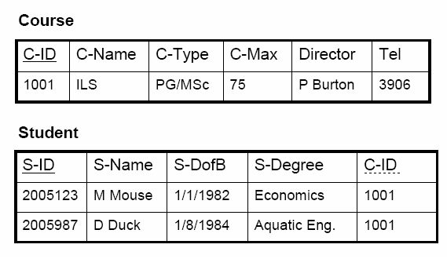
Mapping :1:N Conversion
1:N relationships, post the identifier (Primary Key) from the ‘one’ side as an attribute into the ‘many’ side.
C-MAX
C-TYPE
C-NAME
Course
C-ID
TEL
1
DIRECTOR
FK
Is registered
N
S-DEGREE
Student
S-DOB
S-ID
S-NAME

Slide 37
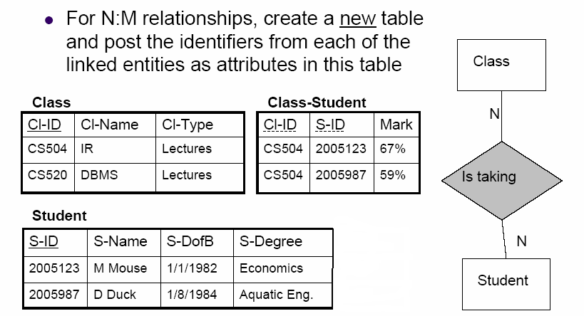
Mapping : M:N Conversion
FK
FK

Slide 38
Mapping : N-array Relationships
ER Model Relational Model
  N-arry relationship “Relationship” relation and n foreign keys
A
B
pk_{B}
pk_{A}
A
B
R
pk_{A}
pk_{B}
pk_{C}
pk_{D}
r
C
D
C
D
pk_{C}
pk_{D}

Slide 39
Mapping : Weak Entities
ER Model Relational Model
Weak Entity Relations and combination of partial and primary keys
1
EMPLOYEE
Employee
ID
Policy
ID
N
DEPENDENTS
Name
Dependents
ID | Name | Age
Age

Slide 40
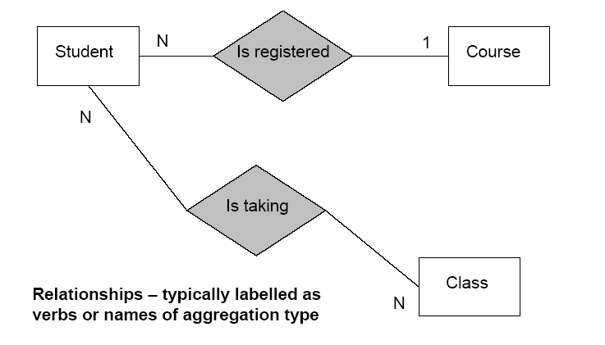
Your Turn – Map to a Relational Schema

Slide 41
Lecture Outline
ER-to-Relational Mapping Algorithm
  Step 1: Mapping of Regular Entity Types
            Multivalued attributes.
            Composite attributes
  Step 2: Mapping of Weak Entity Types
  Step 3: Mapping of Binary 1:1 Relation Types
  Step 4: Mapping of Binary 1:N Relationship Types.
  Step 5: Mapping of Binary M:N Relationship Types.
  Step 6: Mapping of N-array Relationship Types.

Slide 42
Summary of Mapping constructs and constraints
Correspondence between ER and Relational Models
ER Model | Relational Model
Entity type | “Entity” relation
1:1 or 1:N relationship type | Foreign key (or “relationship” relation)
M:N relationship type | “Relationship” relation and two foreign keys
N-array relationship type | “Relationship” relation and n foreign keys
Simple attribute | Attribute
Composite attribute | Set of simple component attributes
Multivalued attribute | Relation and foreign key
Value set | Domain
Key attribute | Primary (or secondary) key

Slide 43
End of Lecture 06
Questions ?

